Slide 1

AI for Mobile Robots

Slide 2
Overview
Scattergram mapping
Implementation
How to implement a simple map assuming the absence of uncertainty

Slide 3
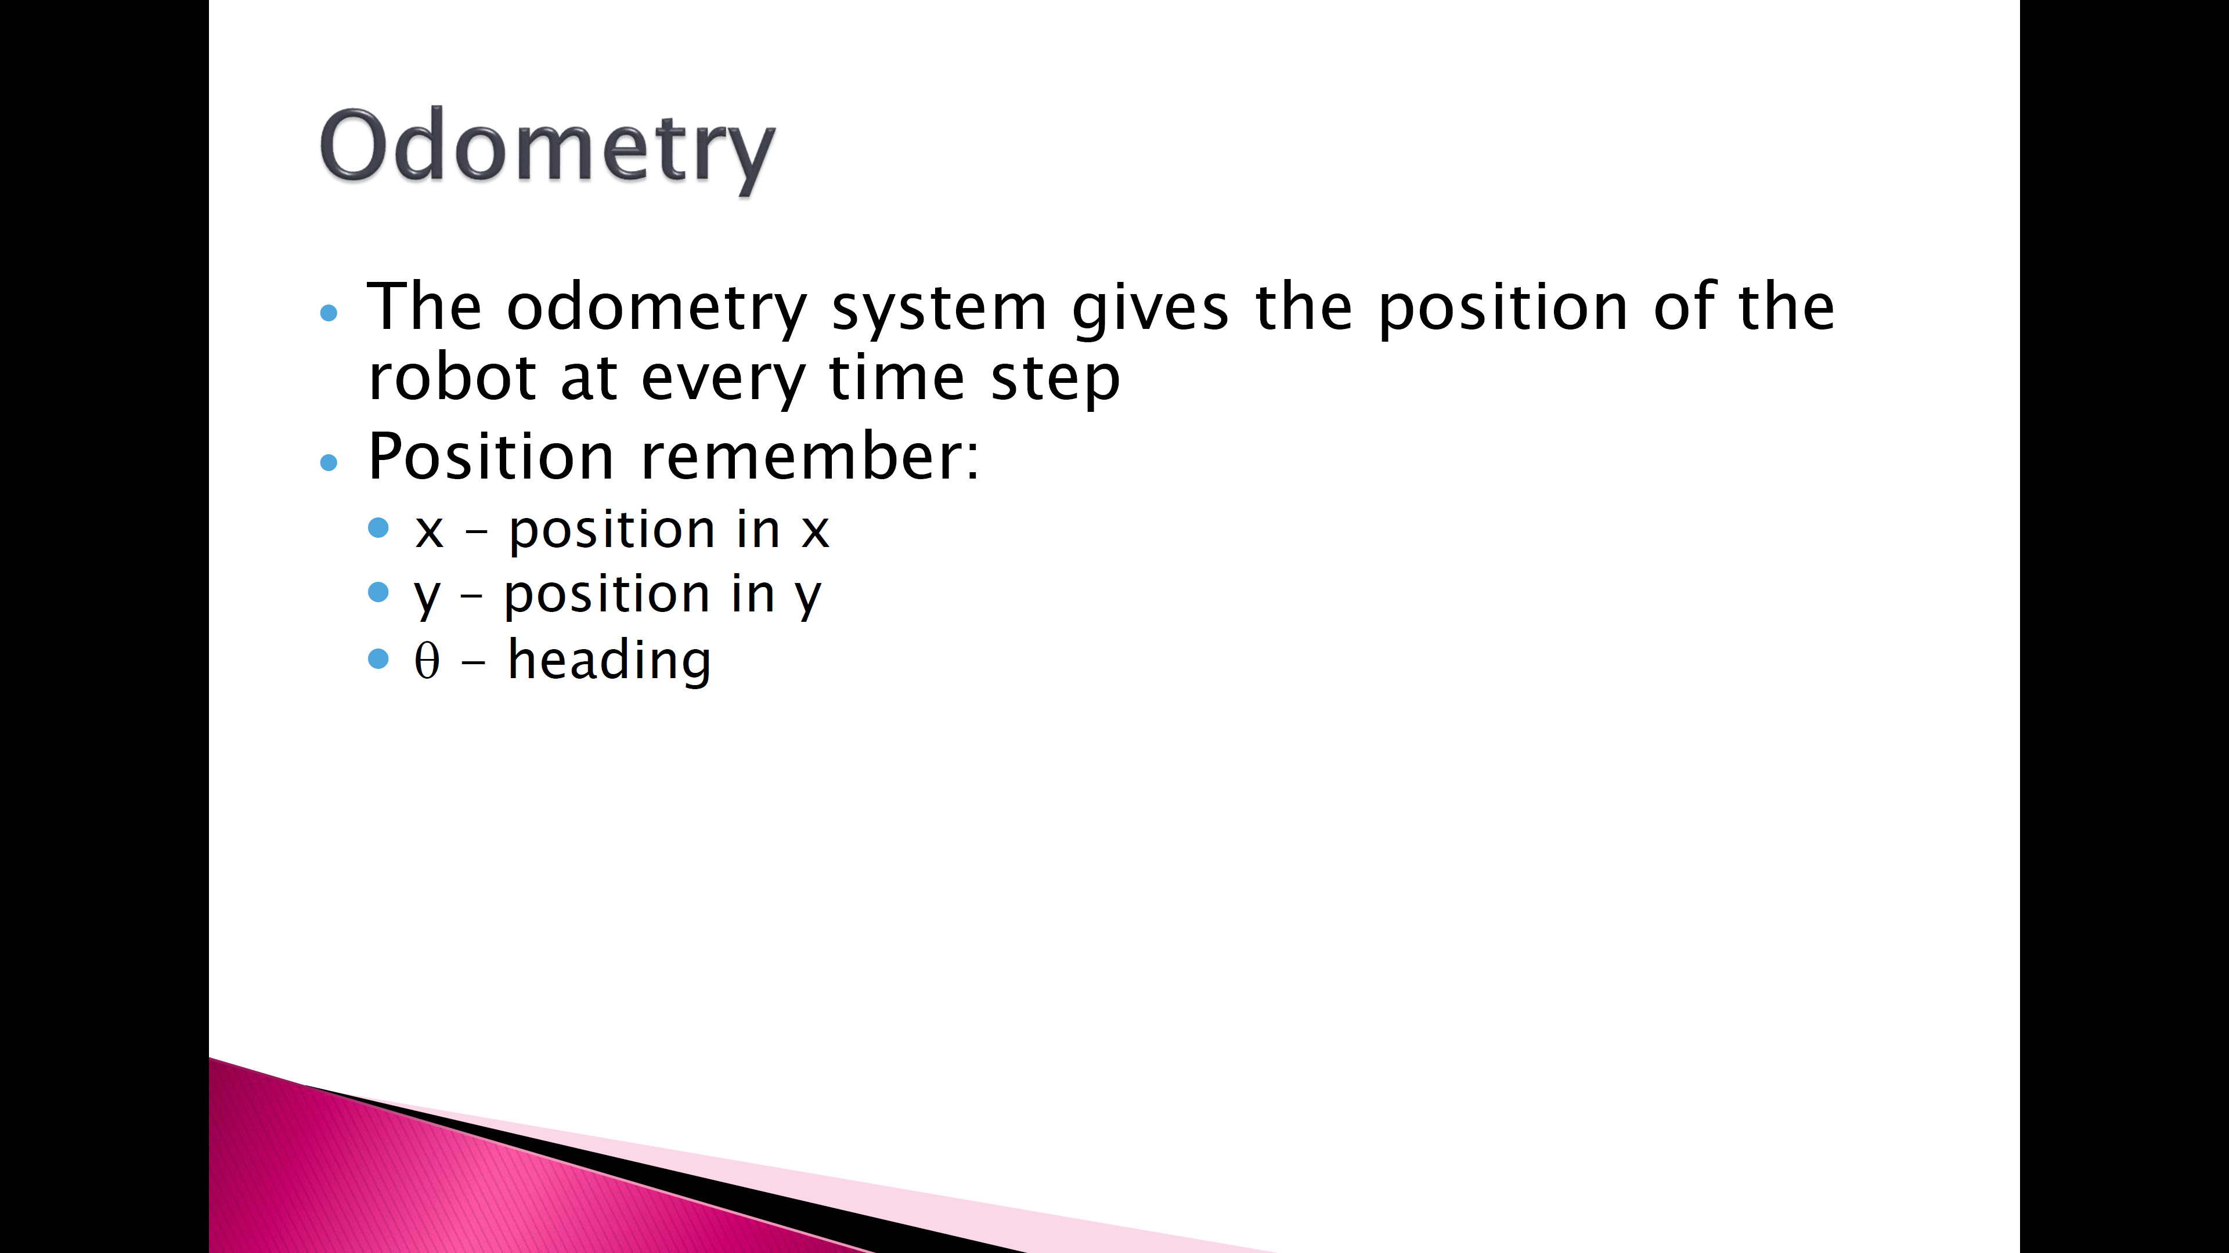

Slide 4
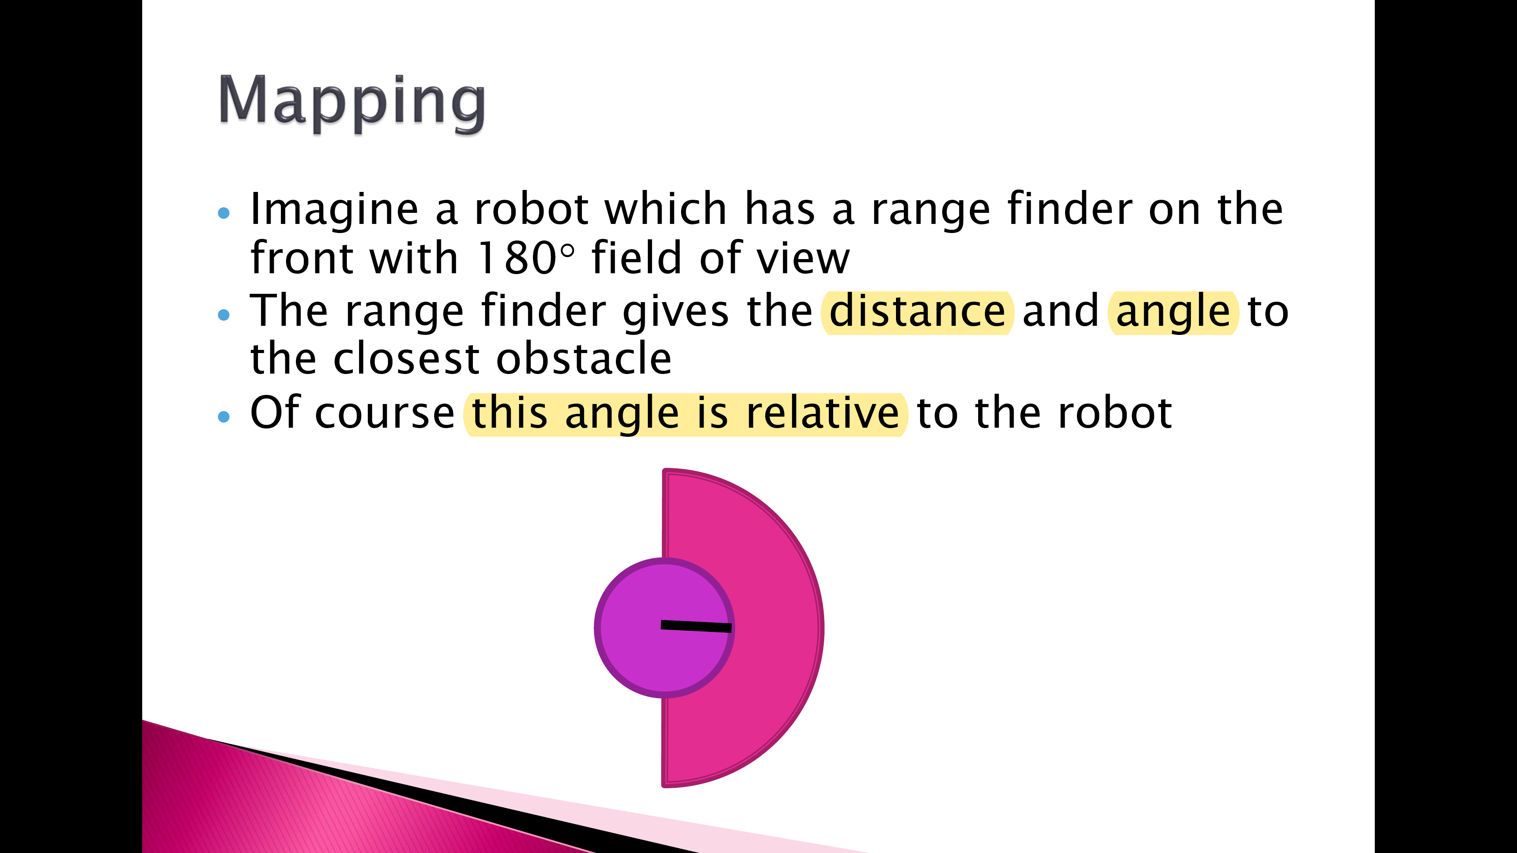
Notes:
an instrument for estimating the distance of an object, especially for use

Slide 5
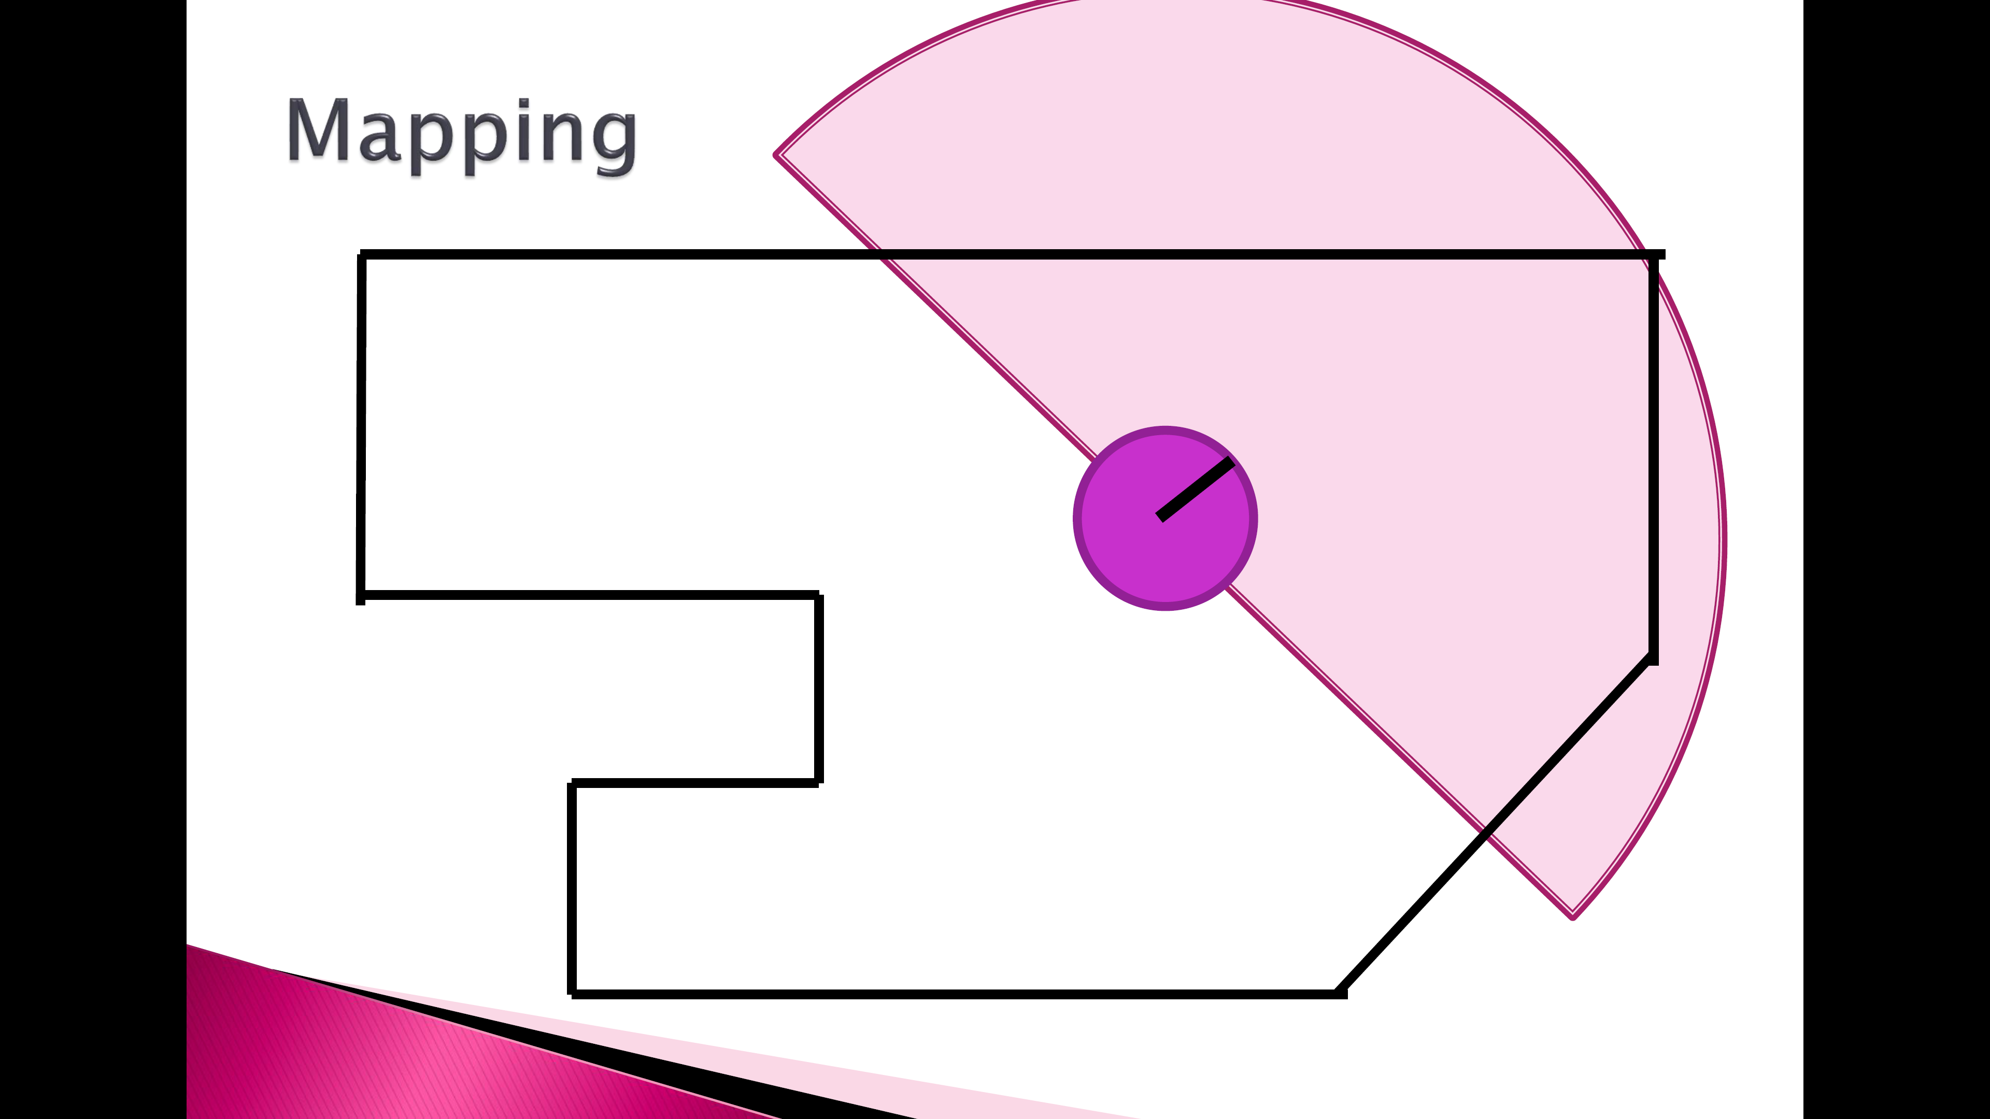

Slide 6
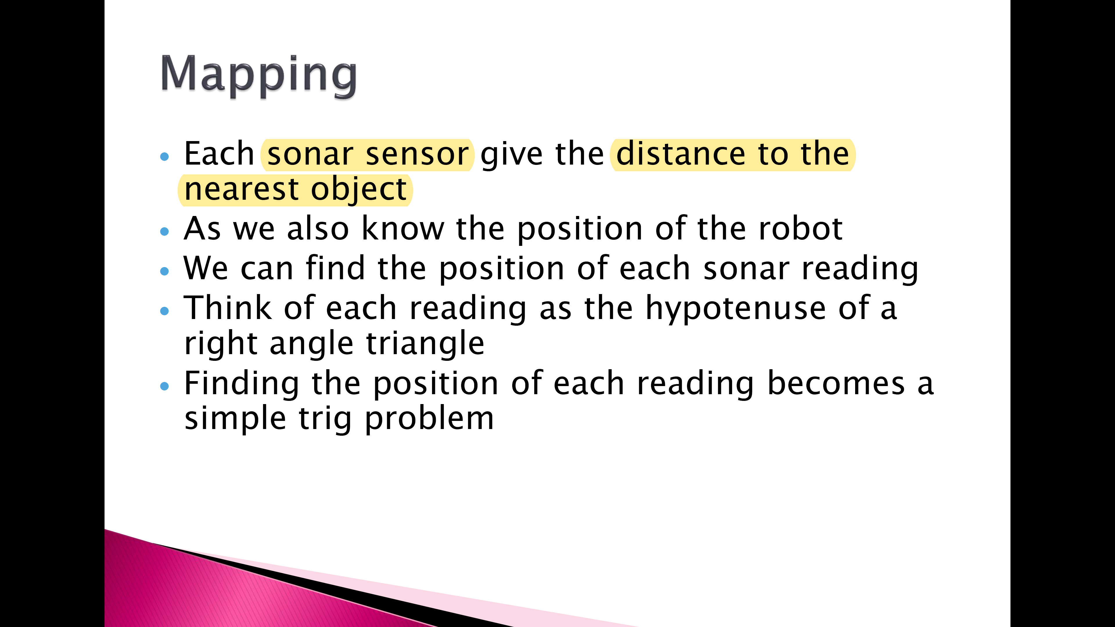

Slide 7


Slide 8
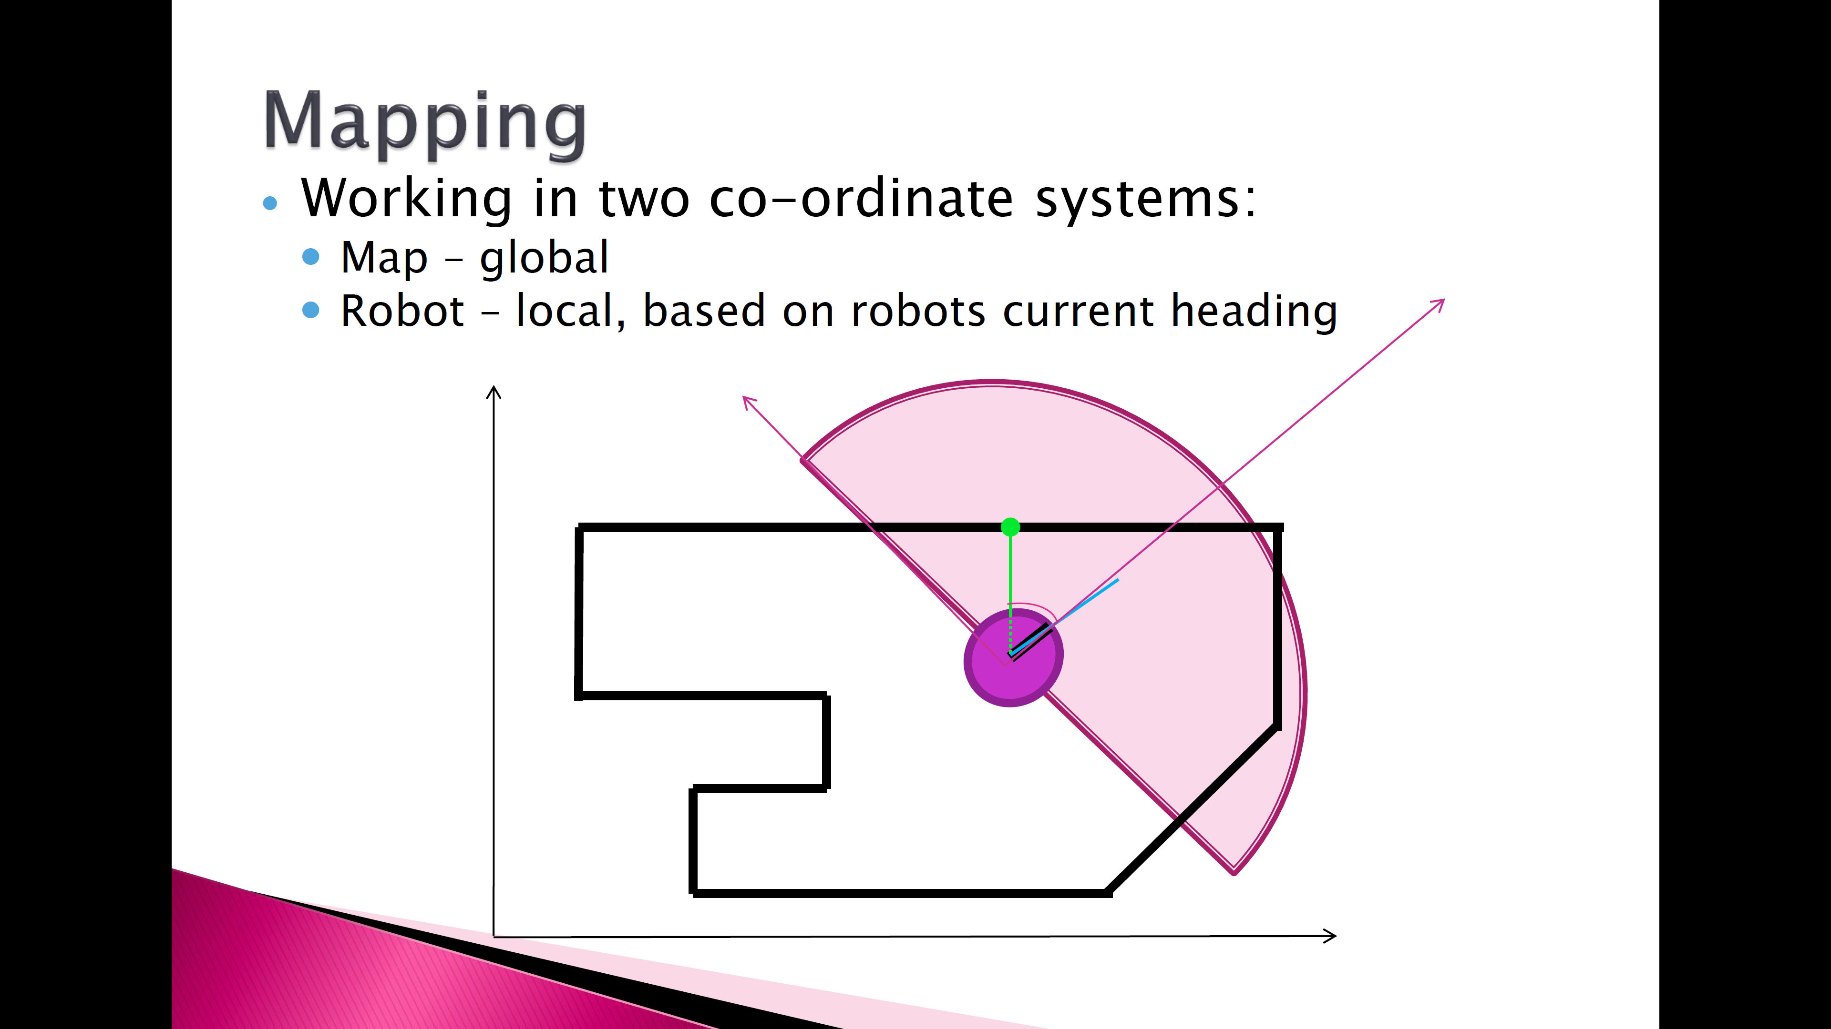
Local
Global

Slide 9


Slide 10
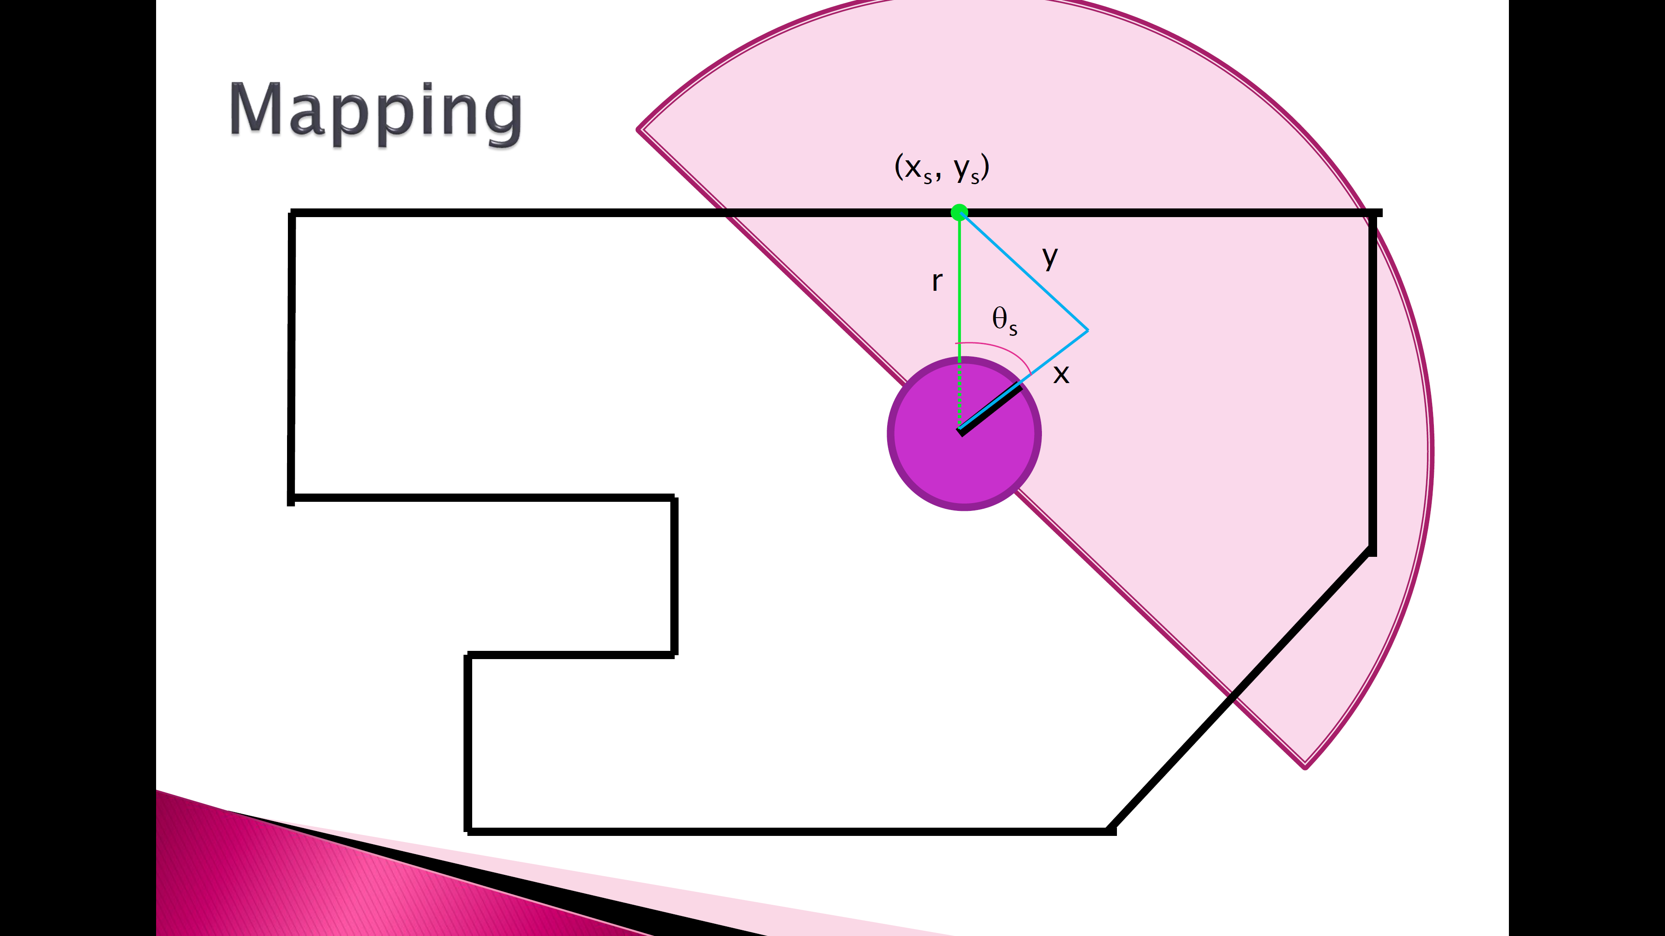

Slide 11
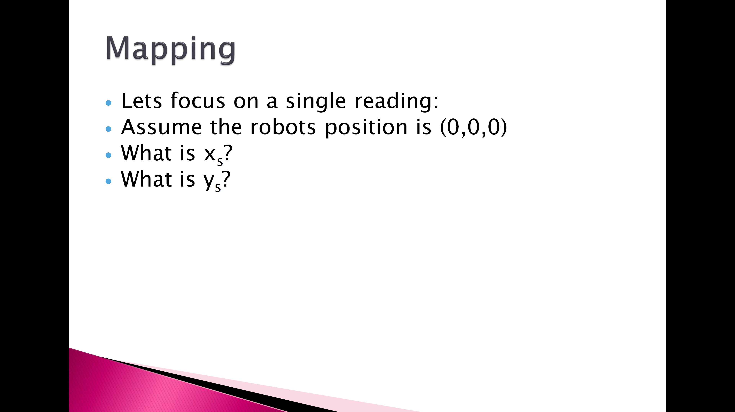

Slide 12
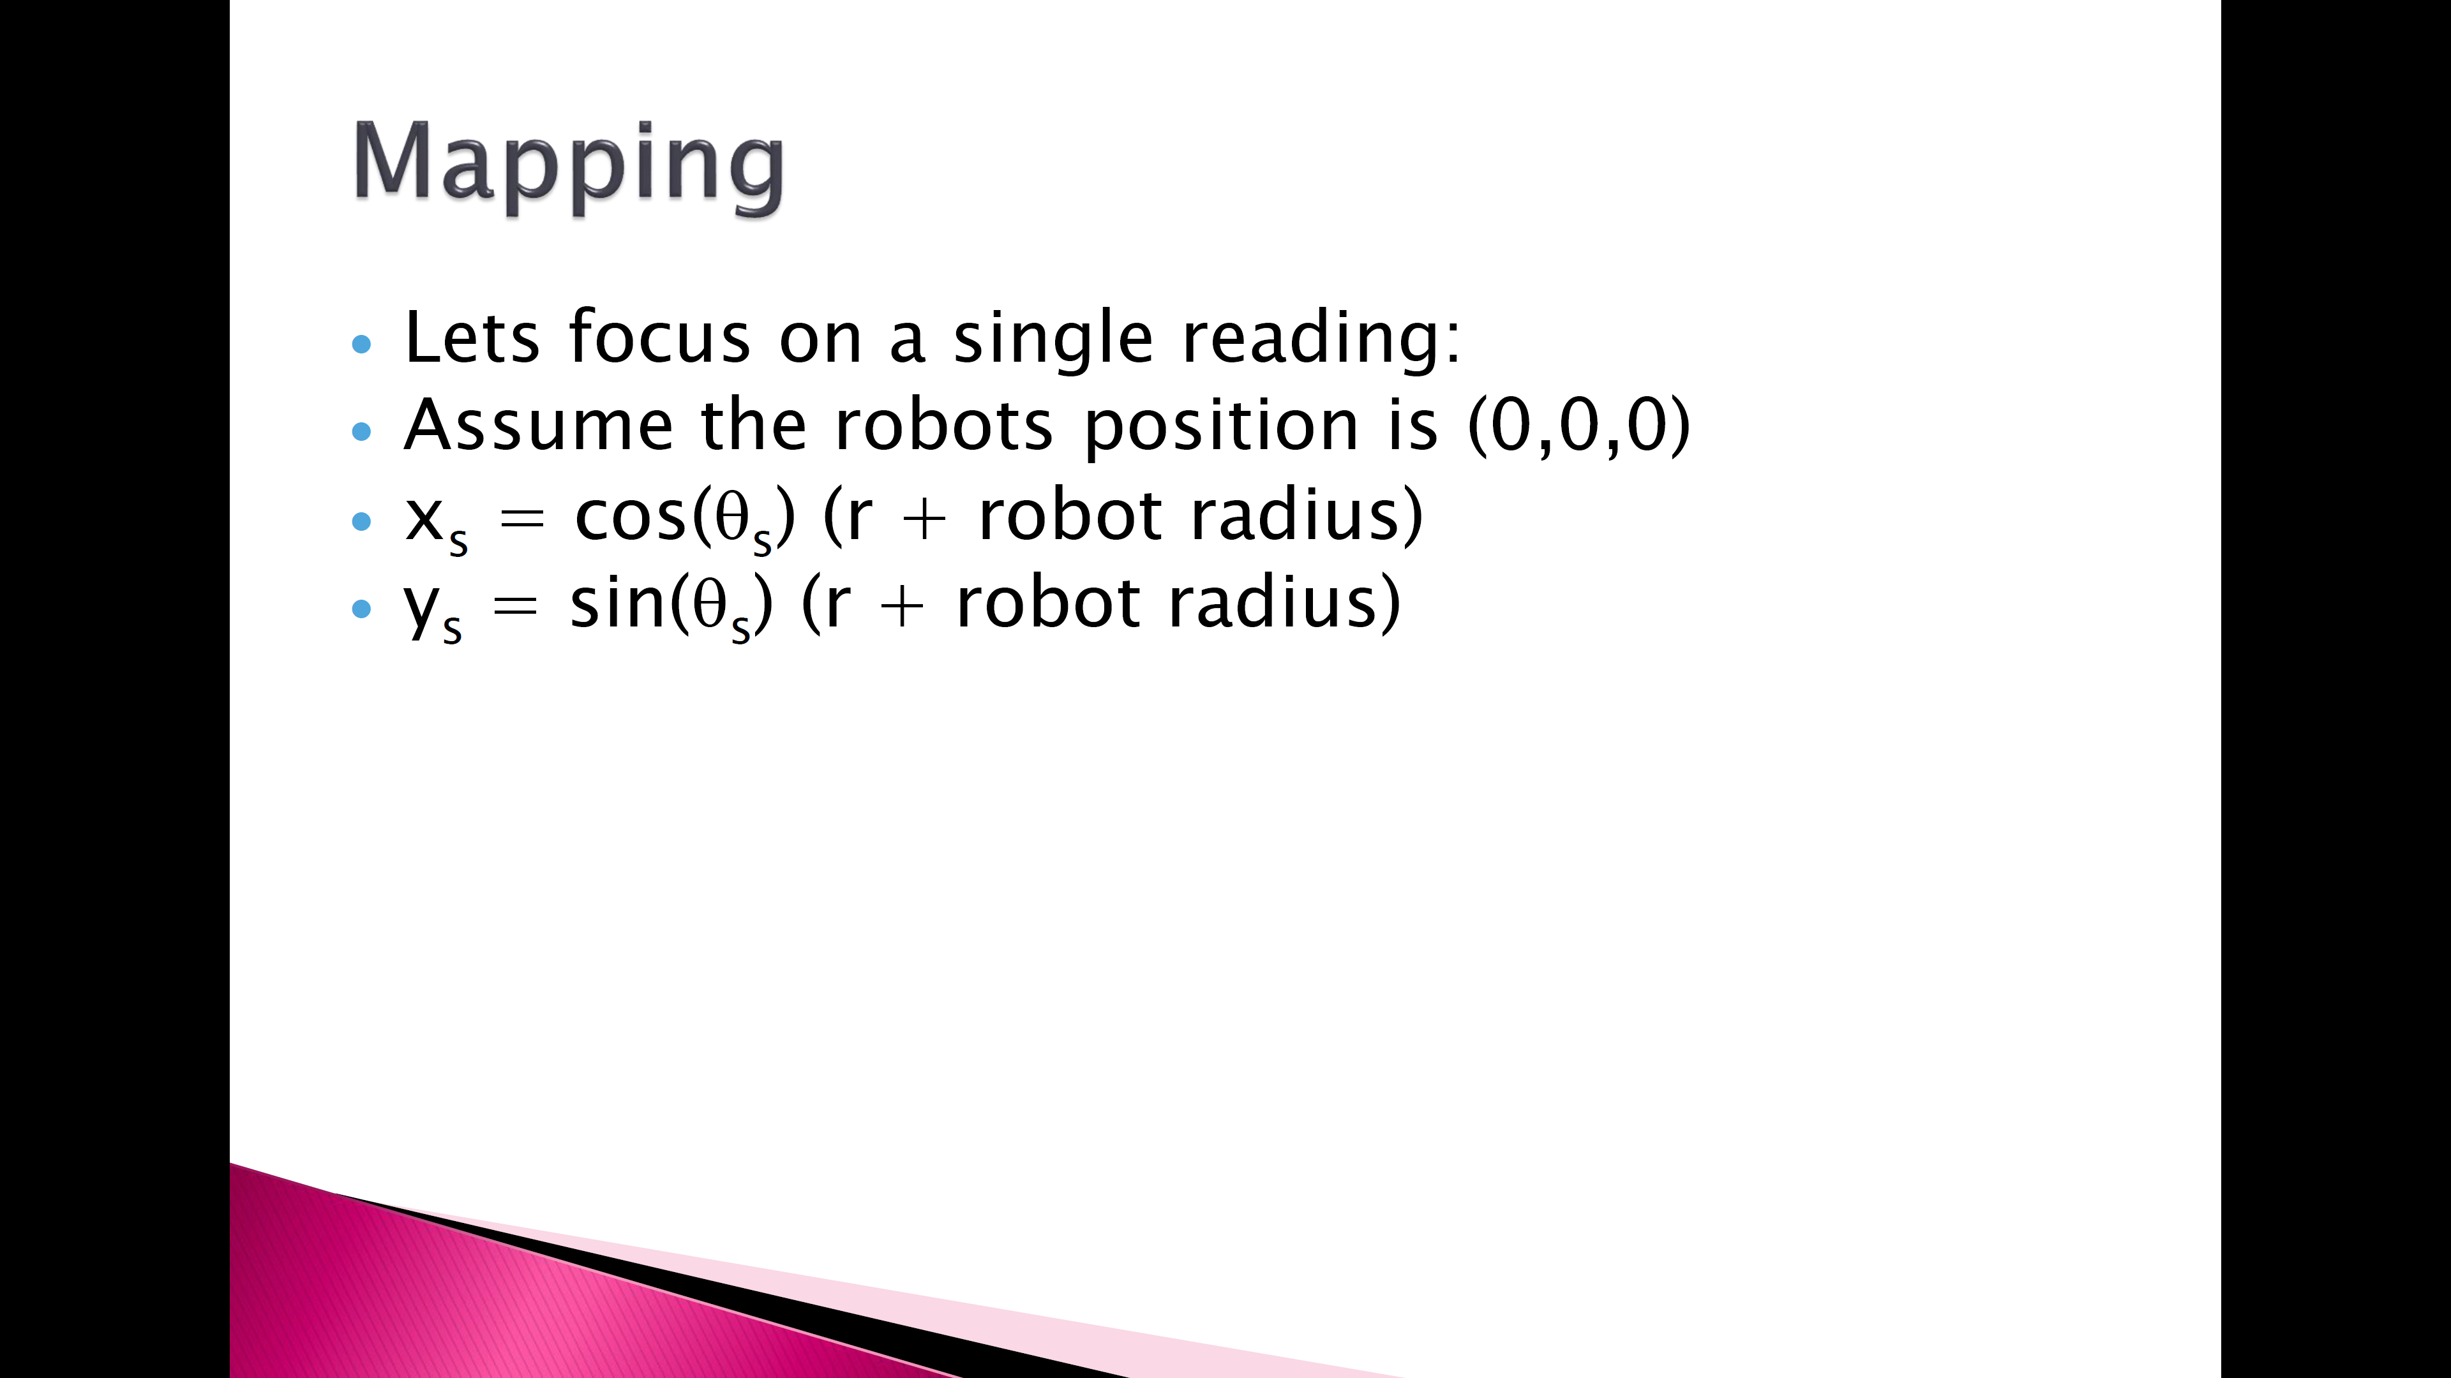

Slide 13
Local
Global

Slide 14
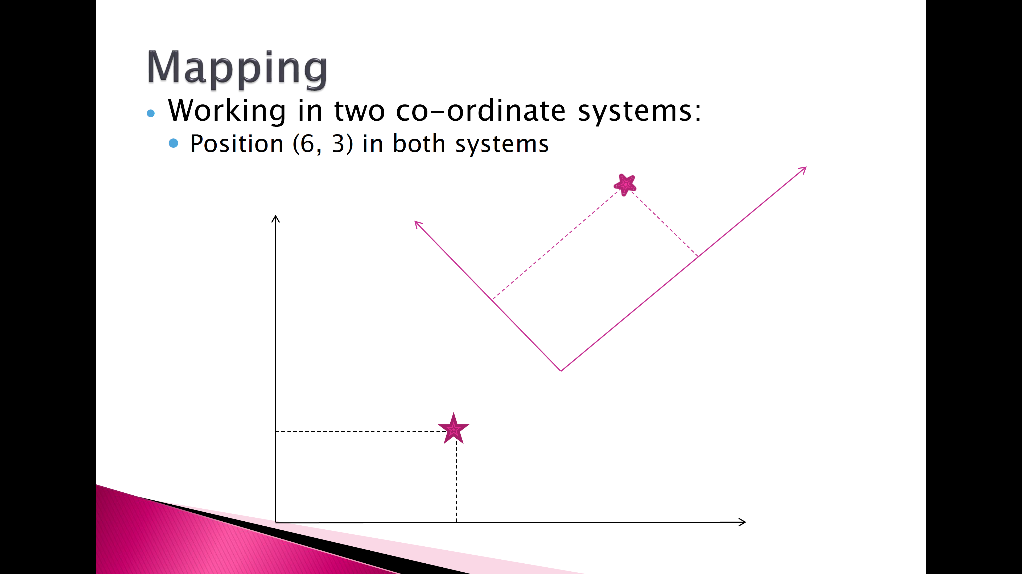
Local
Global

Slide 15
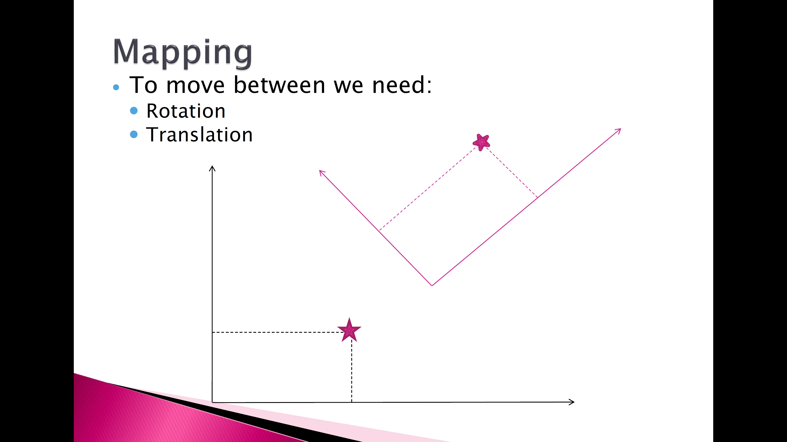
Local
Global

Slide 16
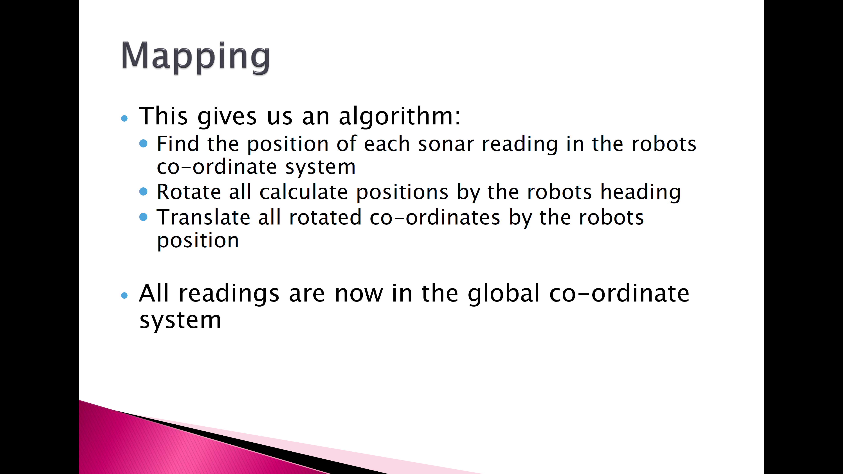

Slide 17
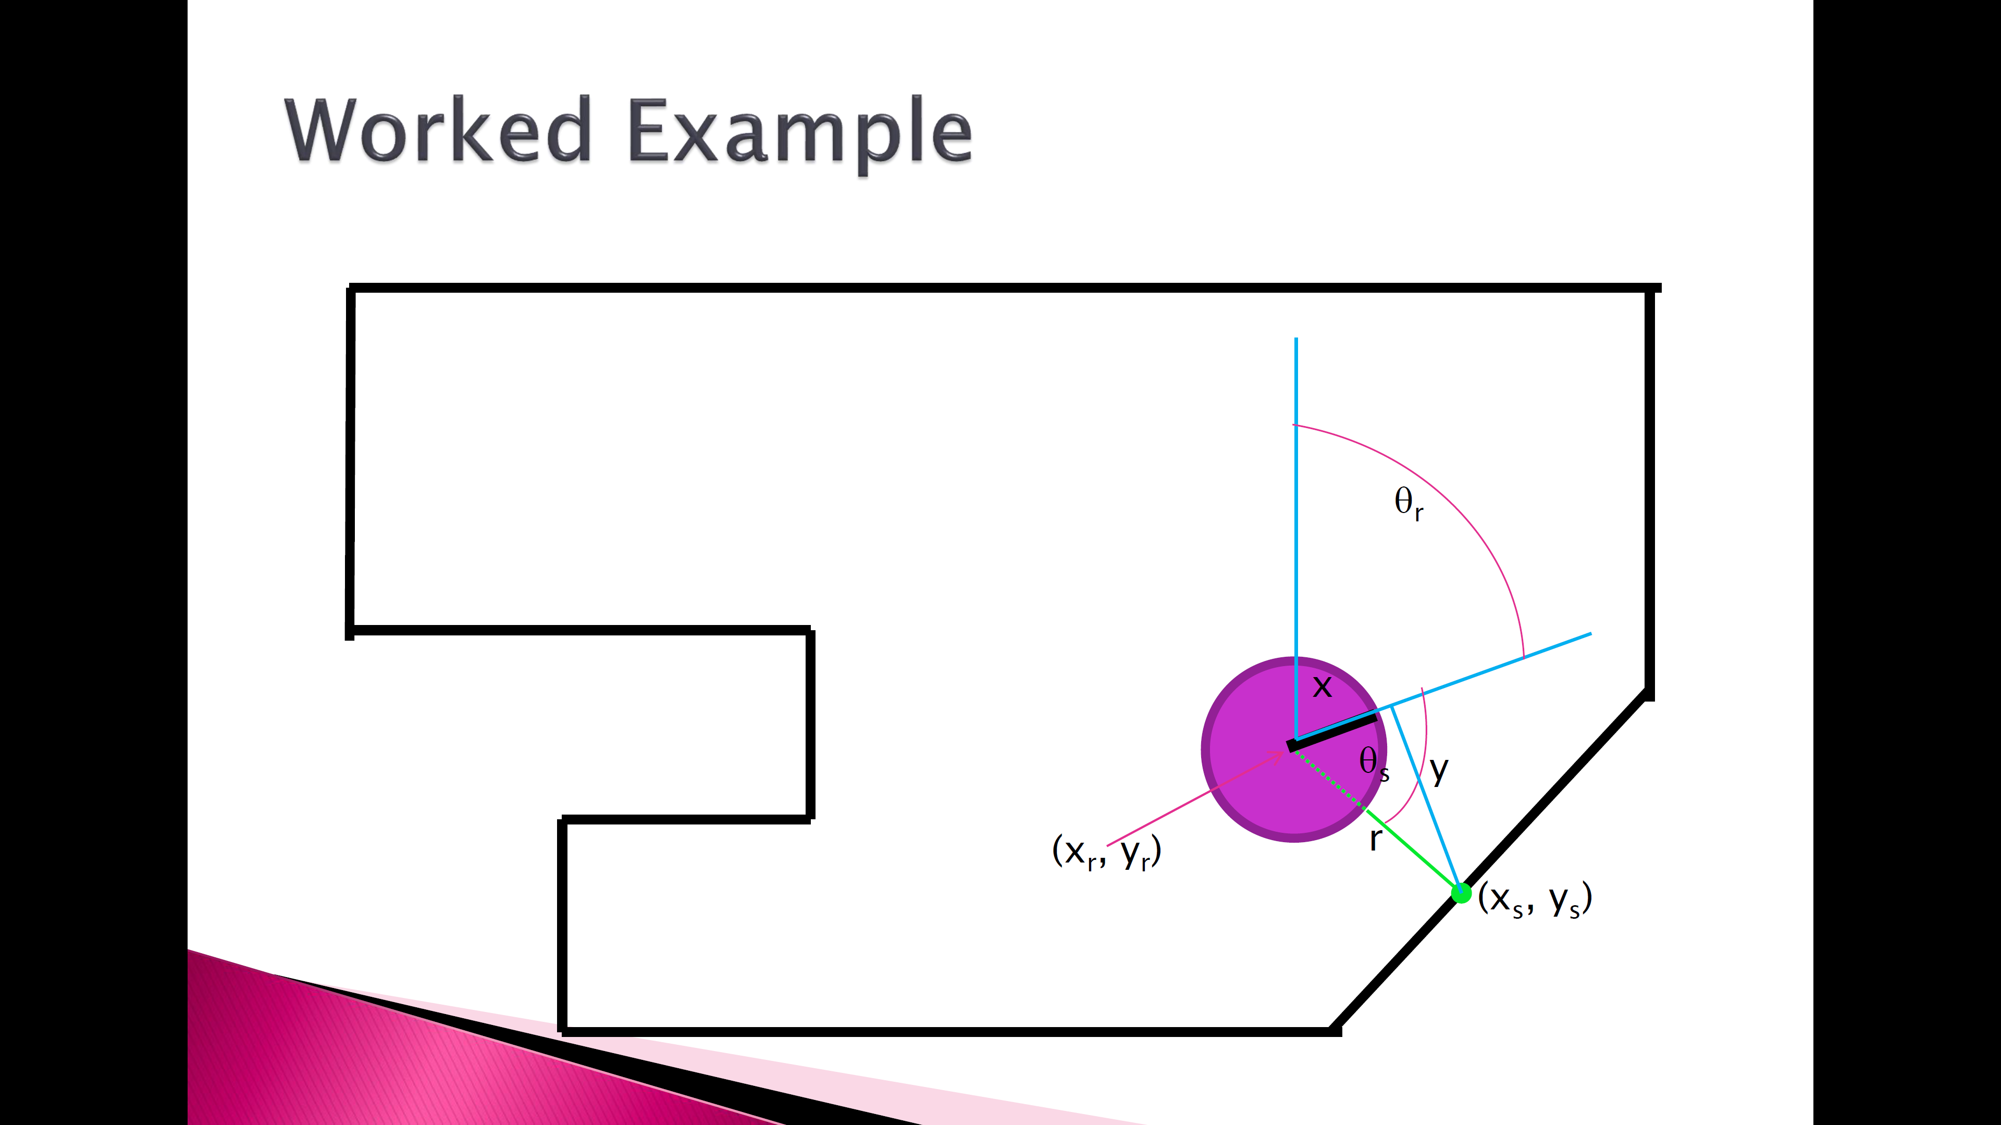

Slide 18
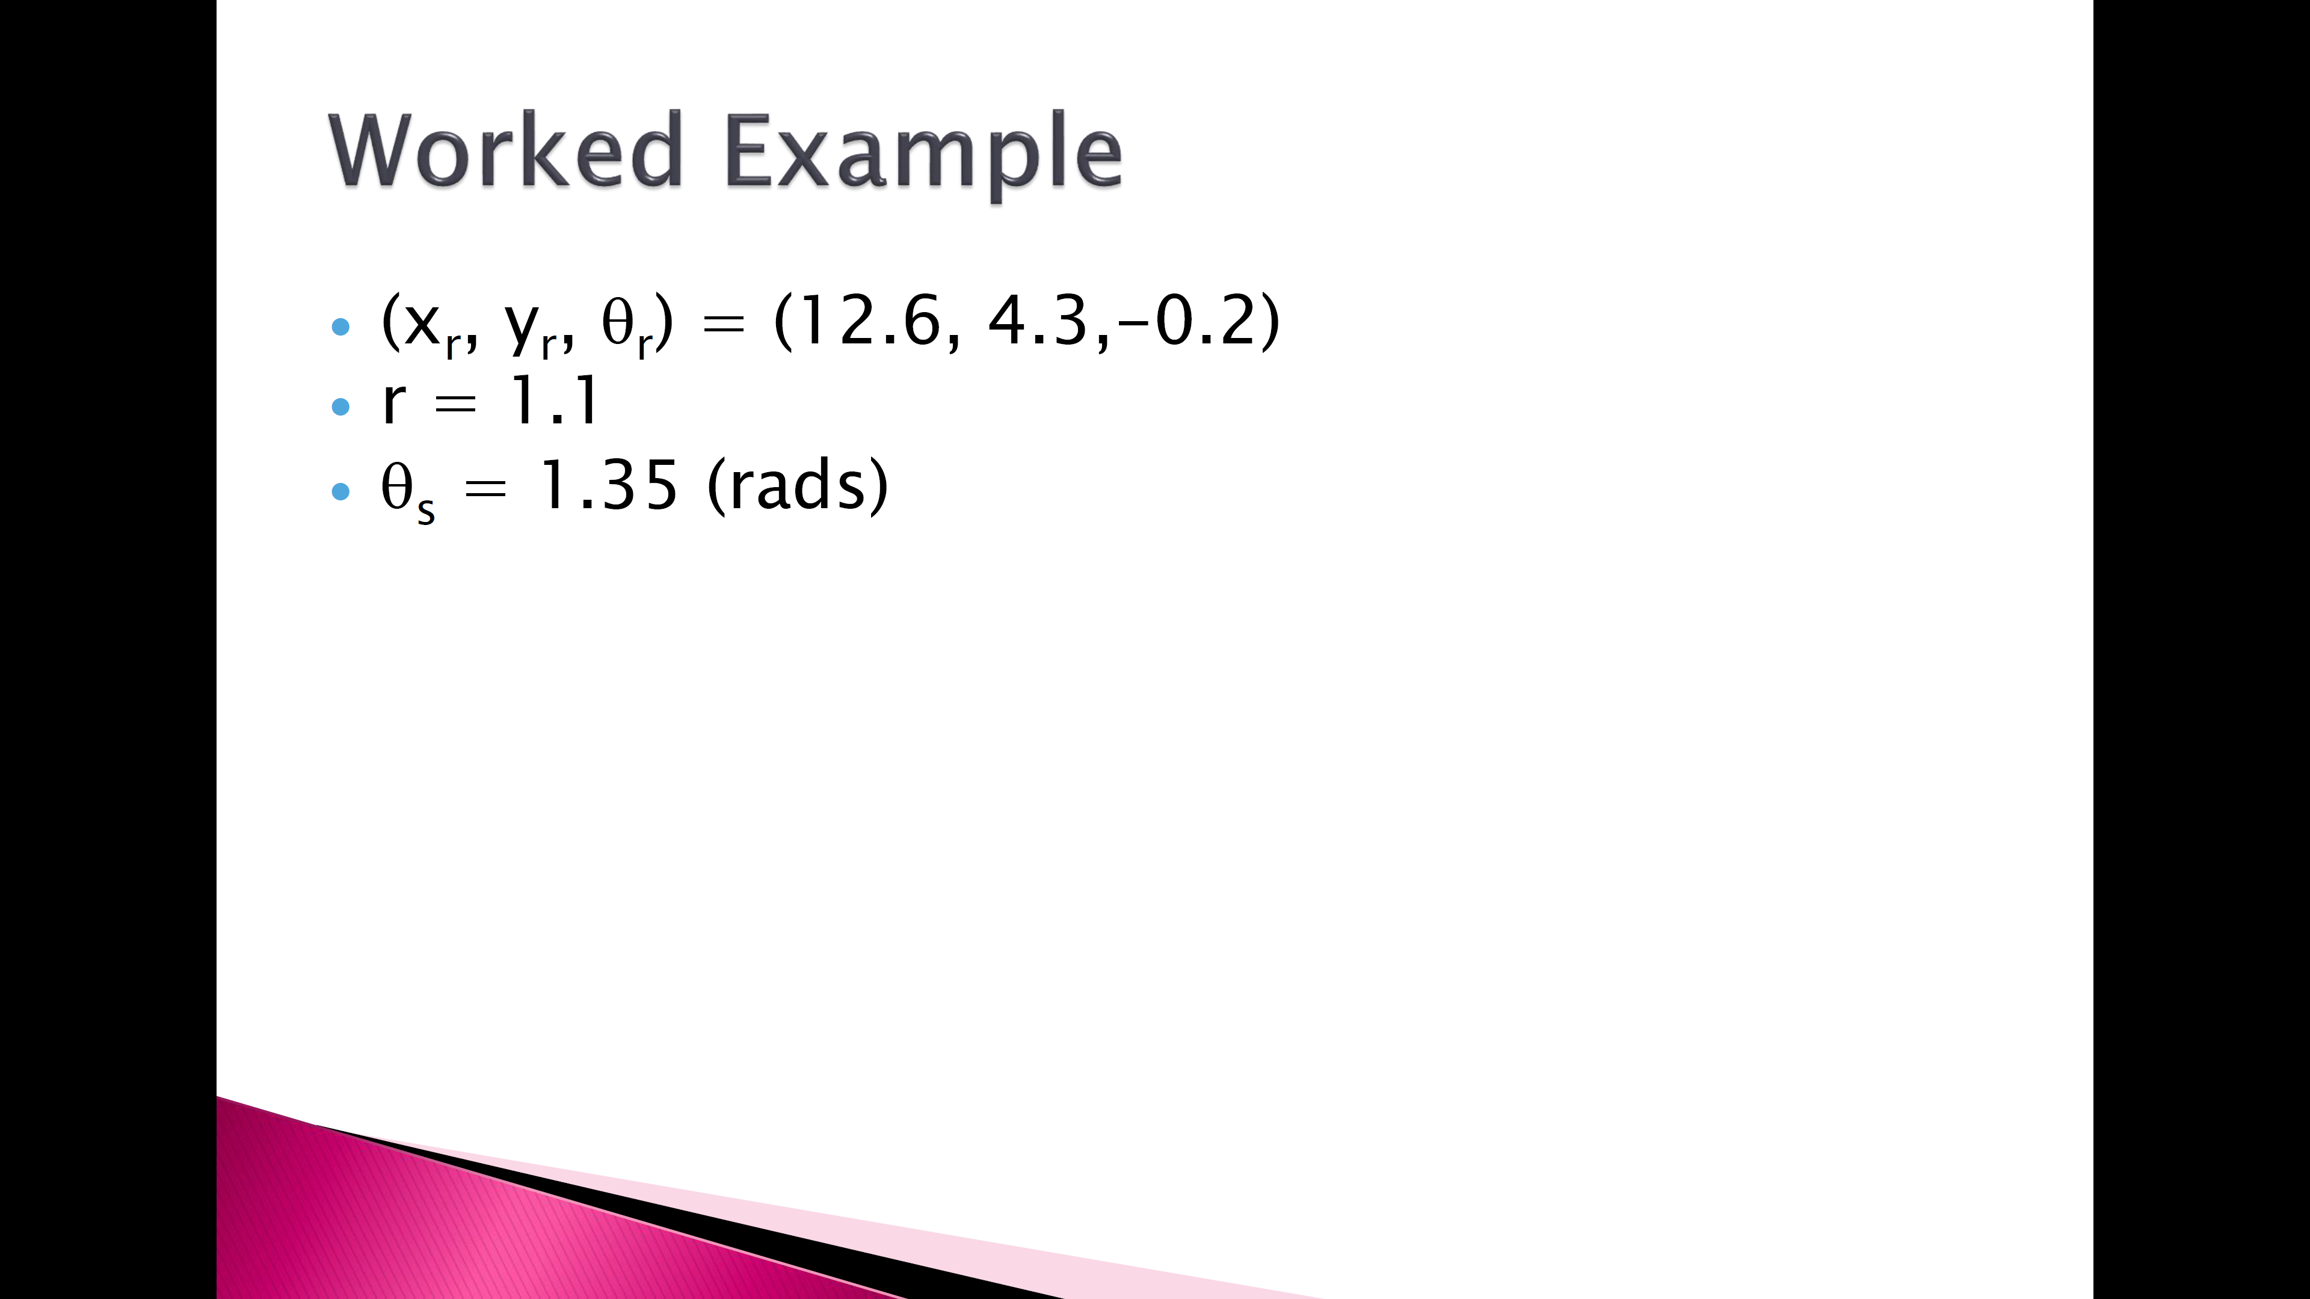

Slide 19
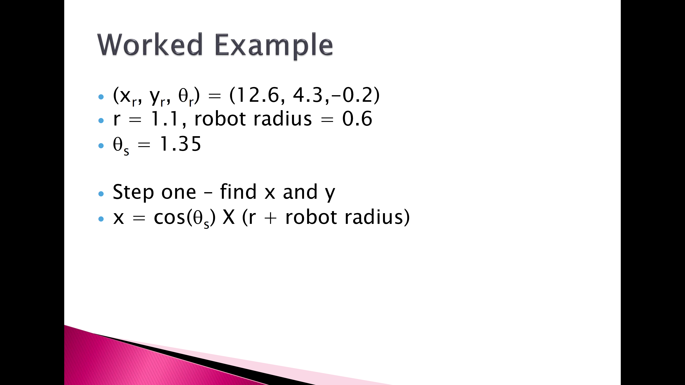

Slide 20
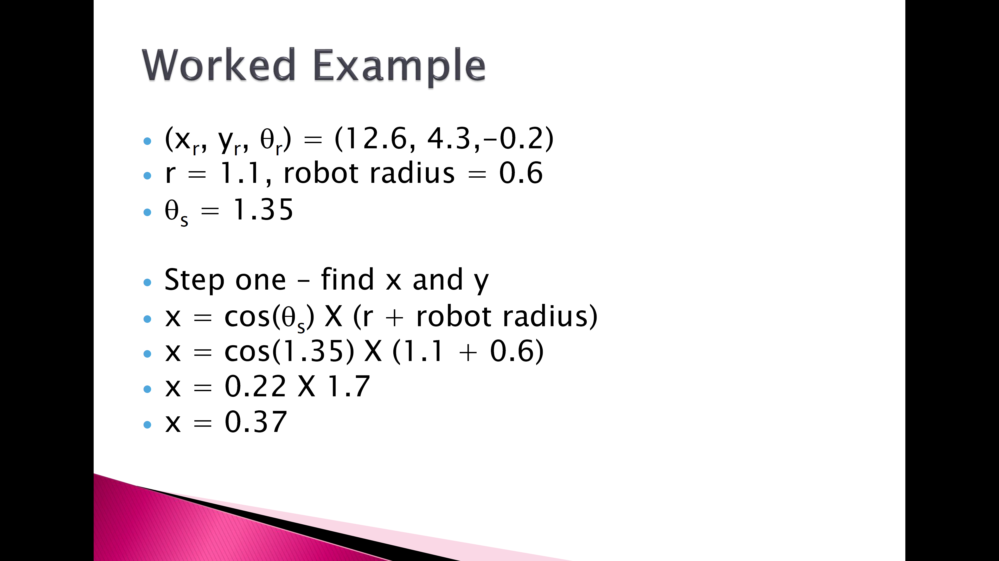

Slide 21


Slide 22

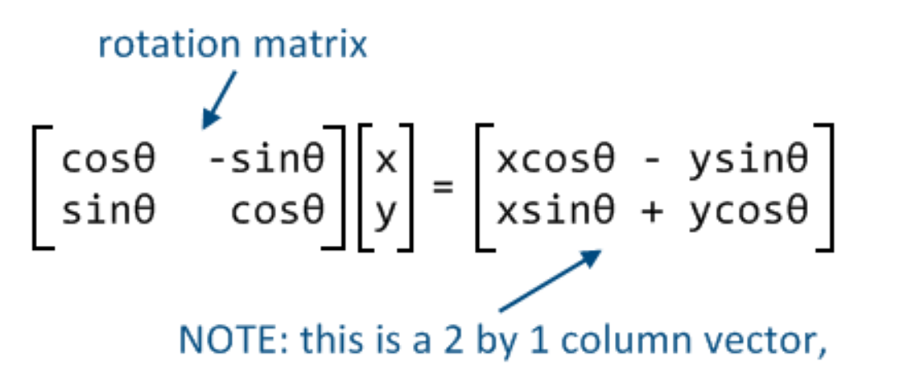
Notes:
http://polymathprogrammer.com/2008/09/01/cartesian-coordinates-and-transformation-matrices/

Slide 23
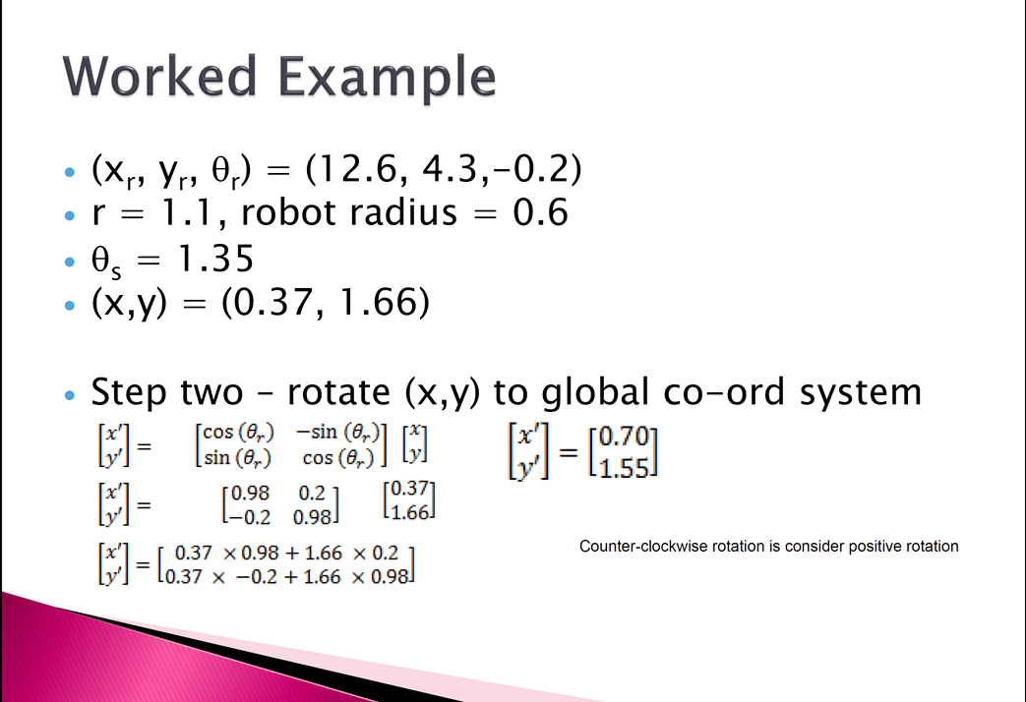

Slide 24
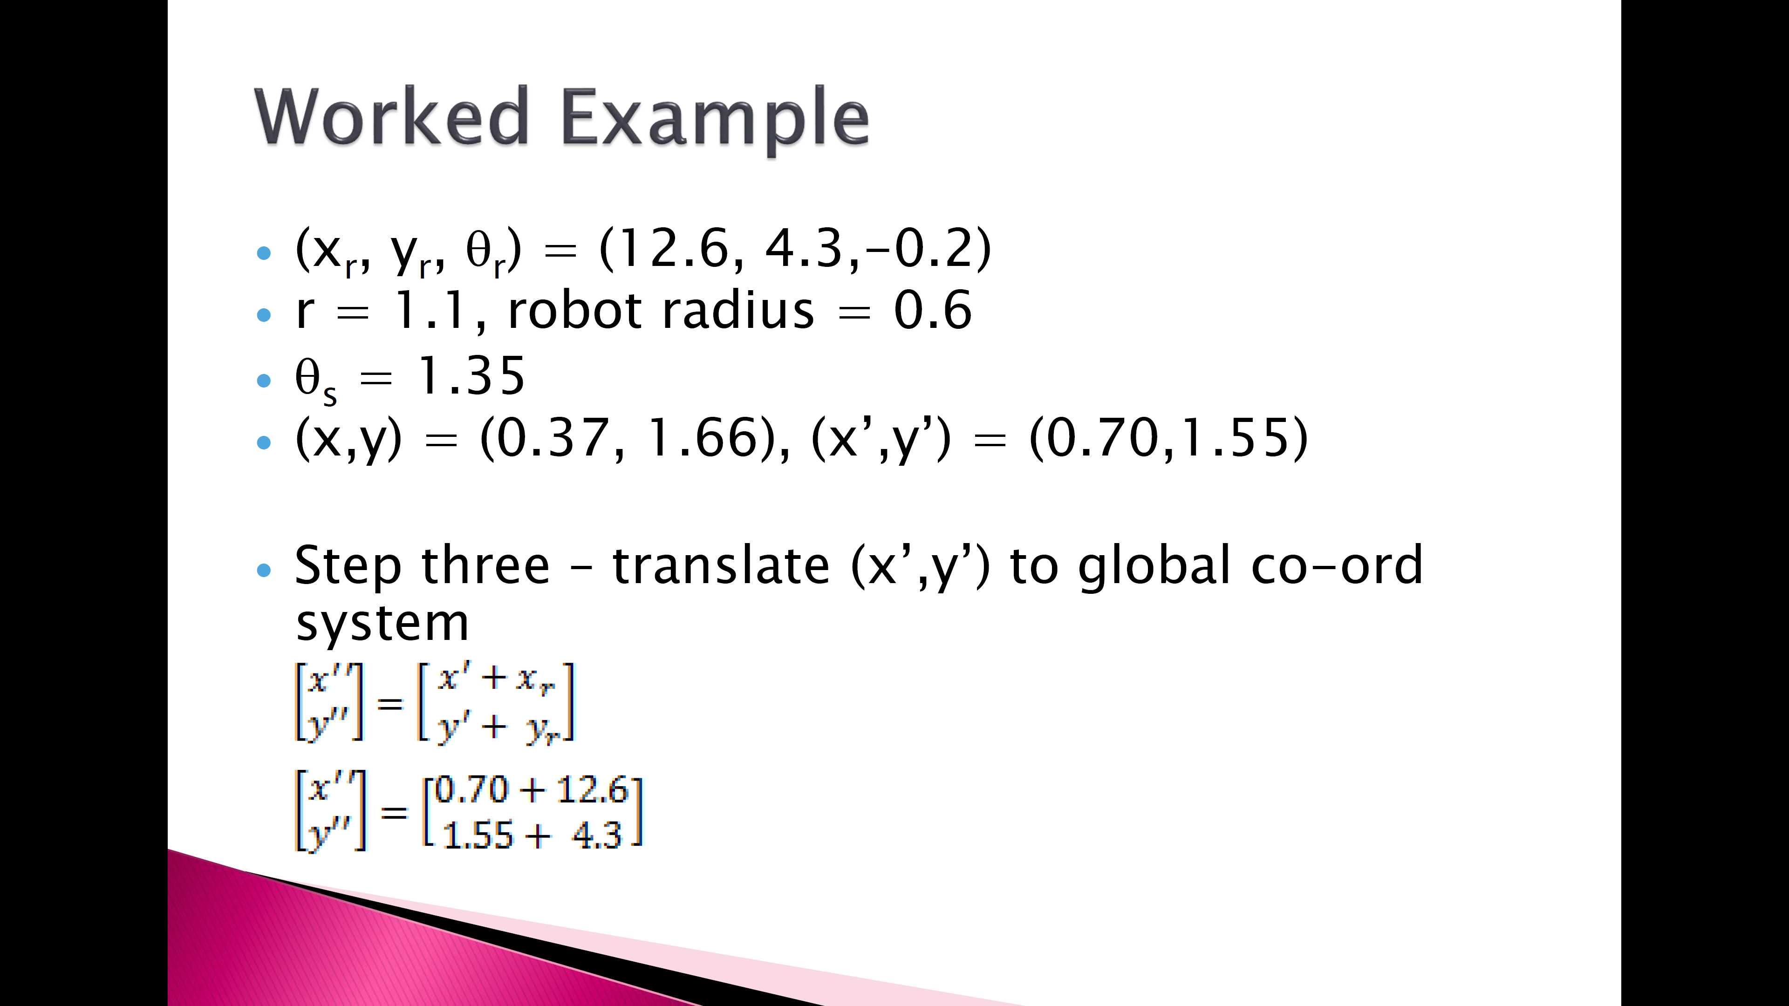

Slide 25
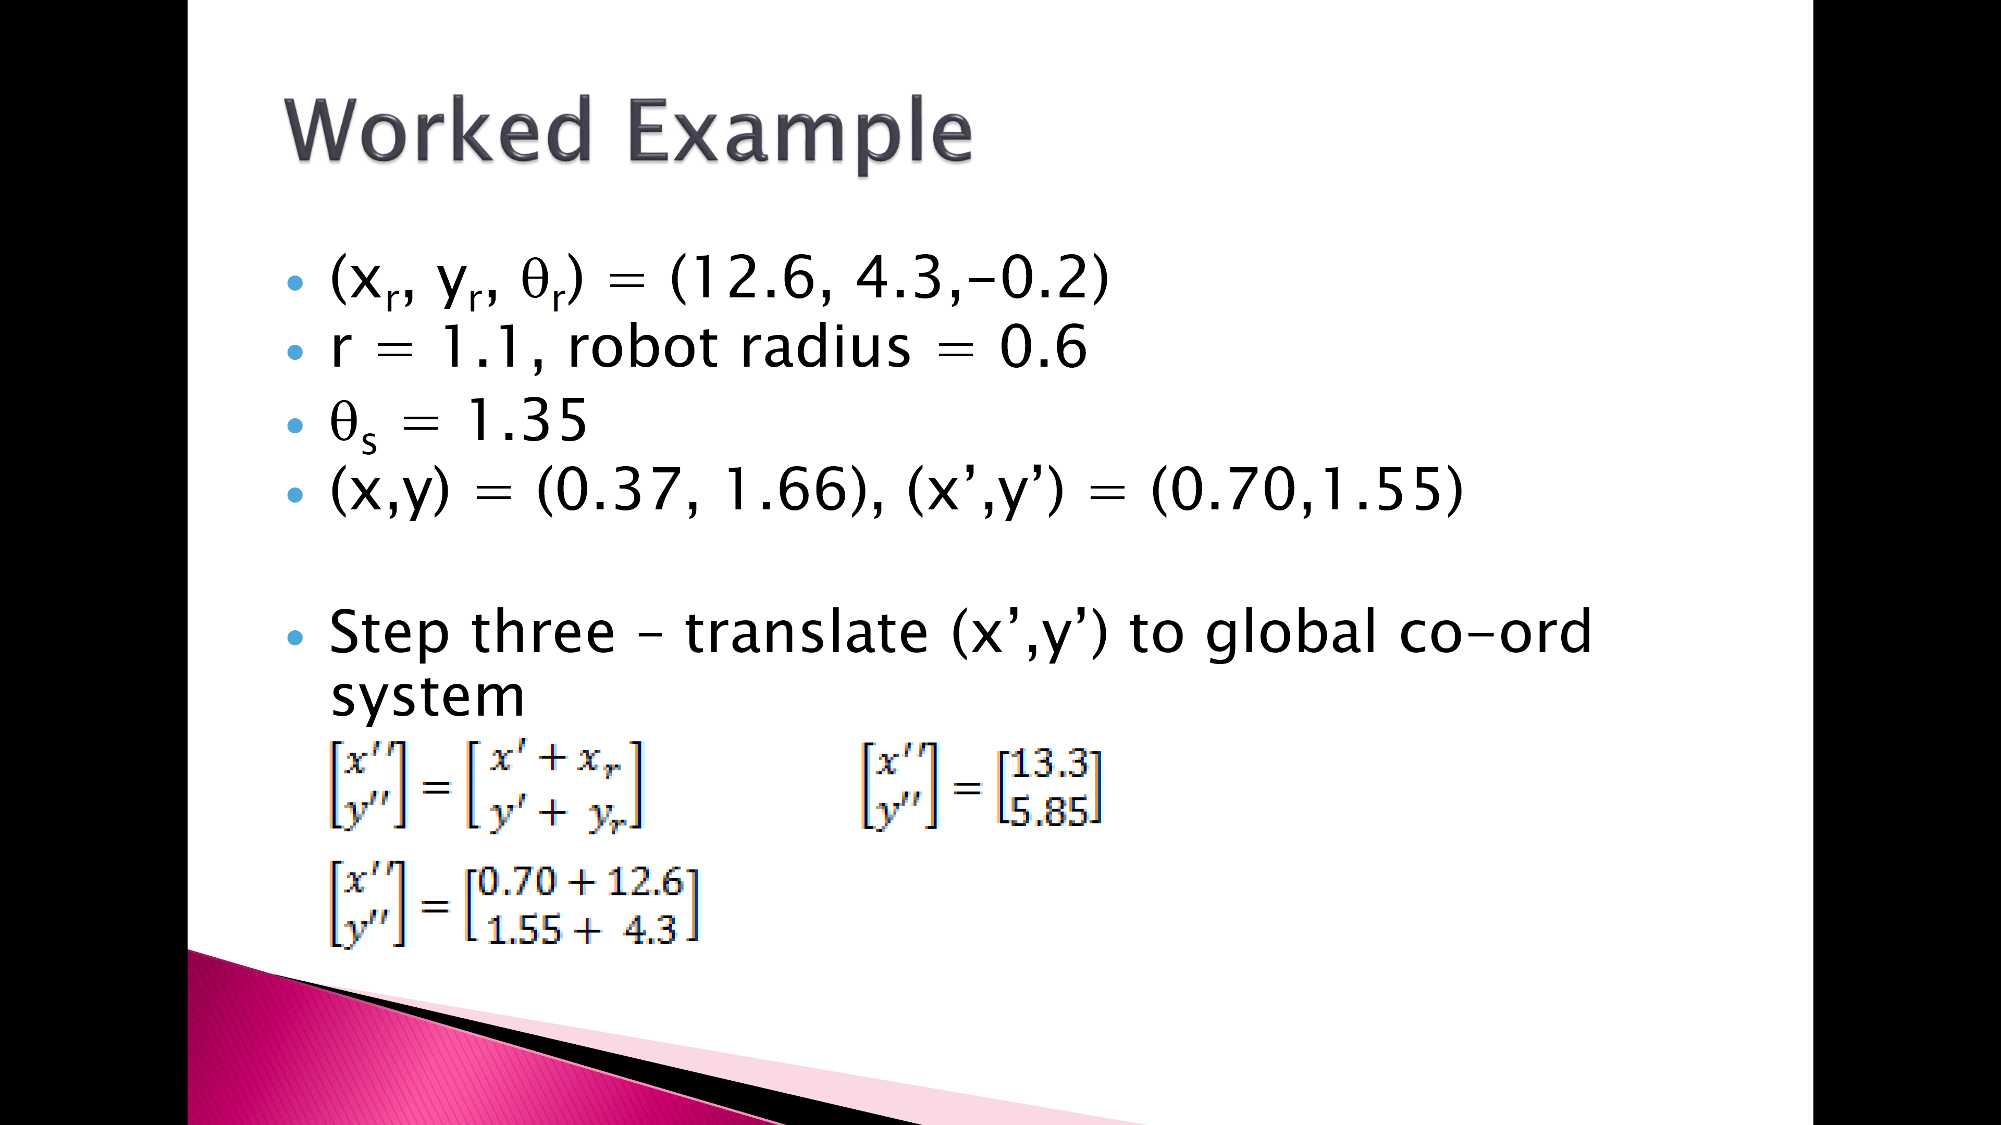

Slide 26

Global

